Slide 1
ECM 104 - OneDrive for Business
How to manage Sharing and Syncing with the Next Gen client

Slide 2
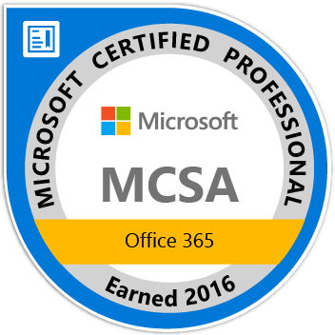
Paul Papanek Stork
Owner/Principal Architect
Don’t Pa..Panic Consulting
http://www.dontpapanic.com
Author
Developer’s Guide to WSS 3.0
MOSS 2007 Best Practices
MCTS: WSS 3.0 Configuration Study Guide (70-631)
SharePoint 2010 Development for Office 365
Microsoft Community Contributor
Technet Forums
MSDN Forums
Yammer Groups
Contact Information
Email: pstork@att.net
Blog: http://dontPaPanic.com/blog
Twitter: @PStork
Notes:
Principal SharePoint Architect for BlueChip Consulting Group
http://www.bluechip-llc.com
SharePoint MVP for 9 years
SharePoint Microsoft Certified Master
Author
Developer’s Guide to WSS 3.0
MOSS 2007 Best Practices
MCTS: WSS 3.0 Configuration Study Guide (70-631)
SharePoint 2010 Development for Office 365
Contact Information
Email: Paul.Stork@bluechip-llc.com
Blog: http://dontPaPanic.com/blog
Twitter: @PStork

Slide 3
Agenda
Current Next Gen Sync client features
Which Version do I Have?
Prerequisites for Next Gen Sync
Installation and Setup
Current Limitations
Automating Installation and Configuration
Managing in the Enterprise
What’s Coming Soon

Slide 4
What Does It Do?
Sync Selected Personal OneDrive Folders
Sync Selected OneDrive for Business Folders
Sync SharePoint Online Libraries and Folders
Extends co-authoring support with Office 2016
Coming Soon – Files On Demand
Windows Creator Edition – Fall 2017

Slide 5
Still on the Roadmap
On-premises Support
Shared with Me Folder
SharePoint Libraries with Information Rights Management (IRM)

Slide 6
Sync Files and Folders

Slide 7
Which Client Do I Have?

Slide 8
Understanding the Versions
Office Prerequisite for latest build
Office 365 ProPlus - 16.0.7167.2
Office 2016 MSI - 16.0.4432.1
Office 2013 MSI/C2R - 15.0.4859.1
Recent updates
Build 17.3.6816.0313 – Windows 10 Creators Update only
Build 17.3.6799.0327 – reliability and stability fixes – Current
Build 17.3.6743.1212 – Sync SharePoint Online Libraries
Build 17.3.6378.0329 – Support for Win 8.1 – 3/30/2016
Other Previous Builds focused on reliability and bug fixes -
https://support.office.com/en-us/article/New-OneDrive-sync-client-release-notes-845dcf18-f921-435e-bf28-4e24b95e5fc0

Slide 9
Transitioning Clients
Automatic
Download from Office 365 (Click to Run), Microsoft Download, or native on Windows 10
Current version should update and transition (remove Groove) when you update Office to the latest version.
Manual
‘OneDrive.exe /takeover’ at command prompt
Requires local Admin
Will trigger a takeover if the Next Gen client is loaded.
https://support.office.com/en-us/article/Transition-from-the-previous-OneDrive-for-Business-sync-client-4100df3a-0c96-464f-b0a8-c20de34da6fa

Slide 10
Removing the Groove Client

Slide 11
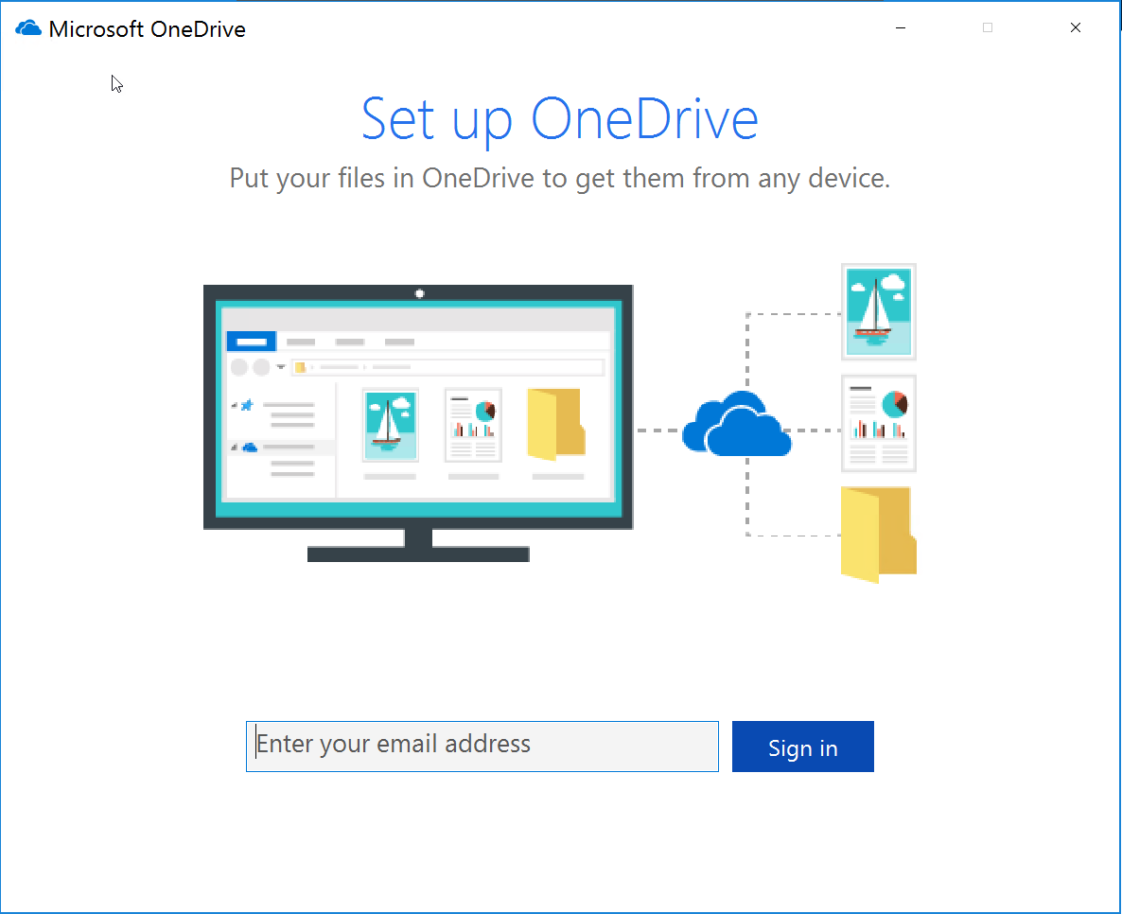
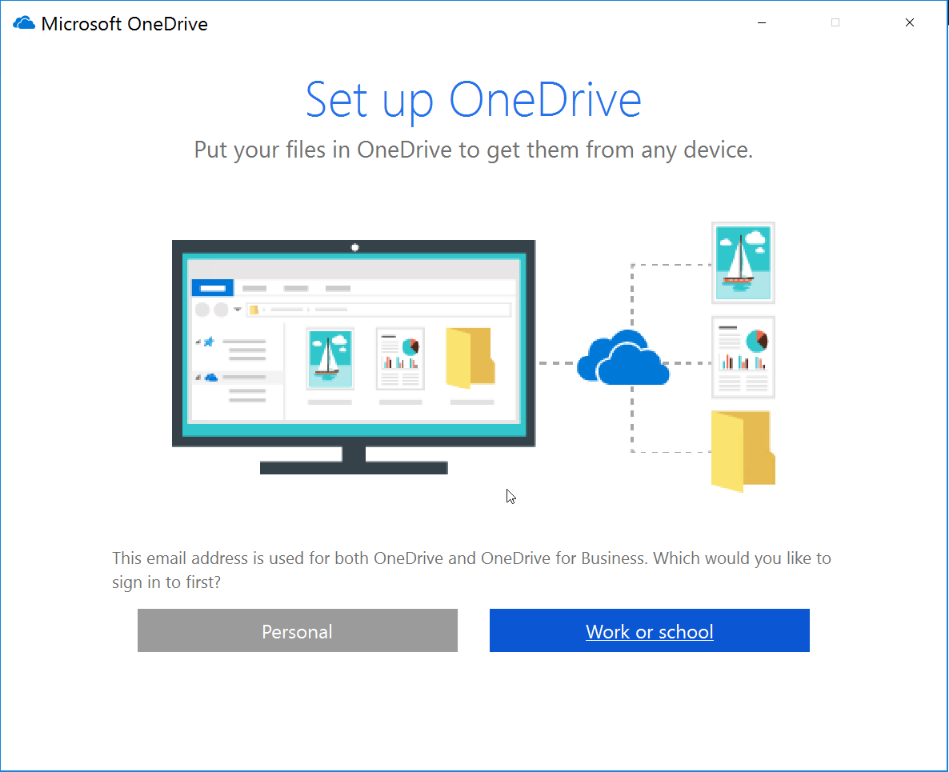
Running the First Time
Enter your email address
Choose
Personal – OneDrive
Work or School – OneDrive for Business

Slide 12
Current Limitations
Invalid Characters in File Names - #, %, <, >, :, ", |, ?, *, /, \
Invalid Folder Names - _t, _w, forms(can’t be in the root)
File Size – Up to 15GB for each file
Sync folder must be local – can’t sync to network mapped drive
Library Settings – Can’t sync library with IRM or Checkout required (SP libraries synced as ReadOnly with Checkout)
Roaming, Mandatory, and Temporary profiles not supported
Not supported on Virtual Desktop Infrastructure
https://support.microsoft.com/en-us/help/3125202/restrictions-and-limitations-when-you-sync-files-and-folders

Slide 13
Installing in the Enterprise
Pre-installed on Windows 10
Use System Center Configuration Manager to deploy the new OneDrive sync client
Sample SCCM file - https://go.microsoft.com/fwlink/p/?LinkId=824069
https://support.office.com/en-us/article/Deploy-the-new-OneDrive-sync-client-in-an-enterprise-environment-3f3a511c-30c6-404a-98bf-76f95c519668

Slide 14
Manage using GPOs
User Configuration GPO settings:
Coauthoring and in-app sharing for Office files
Configure OneDrive.exe to receive updates after consumer production
Prevent users from changing the location of their OneDrive folder
Prevent users from configuring personal OneDrive accounts
Set the default location for the OneDrive folder
Users can choose how to handle Office files in conflict
Computer Configuration GPO settings:
Prevent users from using the remote file fetch feature to access files on the computer
Set the maximum percentage of upload bandwidth that OneDrive.exe uses

Slide 15
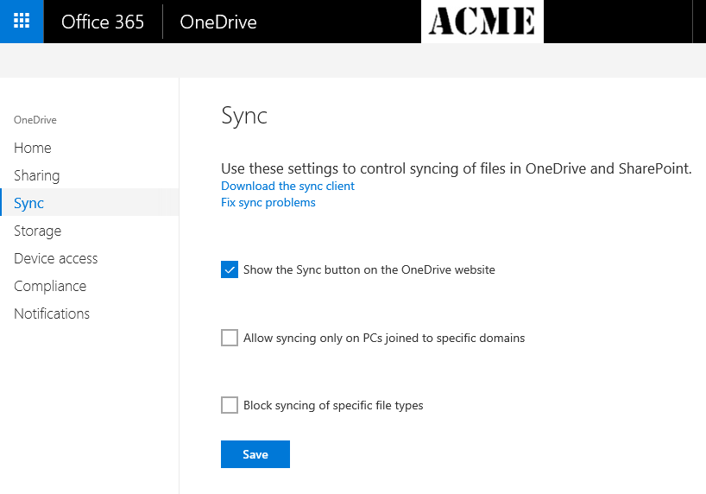
New OneDrive Admin Center
Globally disable the Sync button
Limit Workstations
Allow Sync only to whitelisted domains
Block Sync on Mac OS
Limit File types by extension

Slide 16
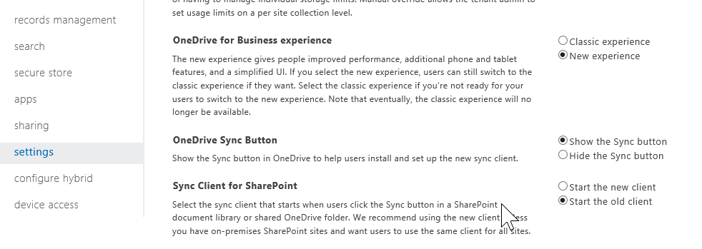
SharePoint Admin Center
OneDrive for Business experience – Classic or New
Globally hide the Sync button
Force Old or New Client

Slide 17
Office 365 Admin Settings

Slide 18
OneDrive – Files On-Demand
#1 requested feature on UserVoice
Coming with Windows 10 Fall Creator Update
Online & Offline files visible in File Explorer
Open Online files directly
Select files to sync
Also for IOS and Android
https://blogs.office.com/2017/05/11/introducing-onedrive-files-on-demand-and-additional-features-making-it-easier-to-access-and-share-files/

Slide 19
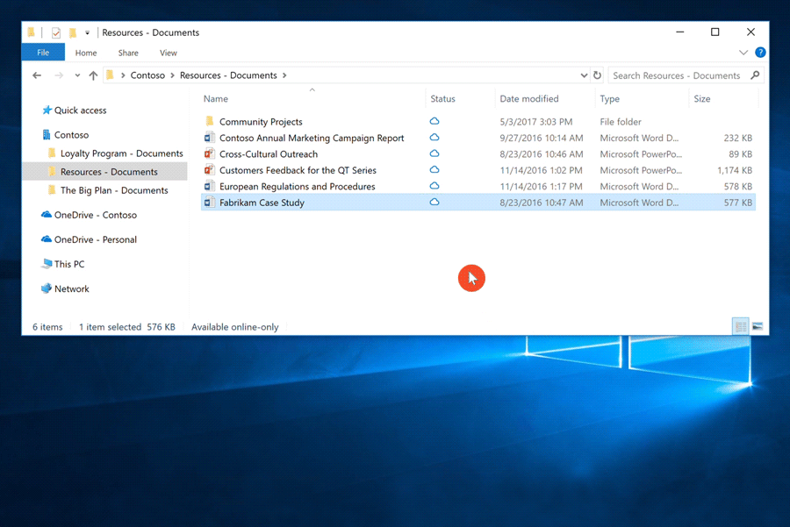
Files On Demand
Controlled in Windows Explorer, Not OneDrive Sync
Uses the Sync Client to manage files

Slide 20
Troubleshooting & Tips
Microsoft Support and Recovery Assistant for Office 365
http://diagnostics.outlook.com/#/
MVA course - OneDrive for Business: Store, Sync, and Share Your Work Files
https://mva.microsoft.com/en-us/training-courses/onedrive-for-business-store-sync-and-share-your-work-files-8527?l=OB1Ov6mz_8704984382
Watch your diskspace
Limit the Libraries you Sync
Sync Selected Folders from OneDrive

Slide 21
Questions?
Contact Info
Email: pstork@att.net
Blog: http://dontPaPanic.com/blog
Twitter: @PStork

